Slide 1
ORACLE LAB 1

Slide 2
Pre-requisites
Oracle 10g express edition installed
Basic database knowledge

Slide 3
HOW TO LOGIN…?
START MENU-> ALL PROGRAMS -> ORACLE
DATABASE 10g EXPRESS EDITION-> GOTO
DATABASE HOME PAGE (Click Here) to open

Slide 4
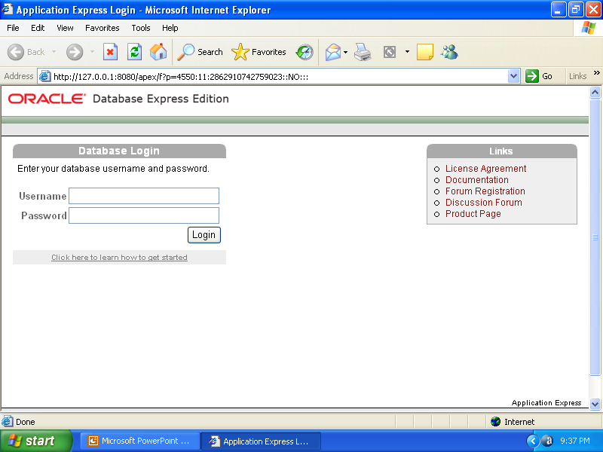
Login Page…

Slide 5
In Login Page
Put your
Username
PassWord
Click on the Login Button
Next page will appear as follows:

Slide 6
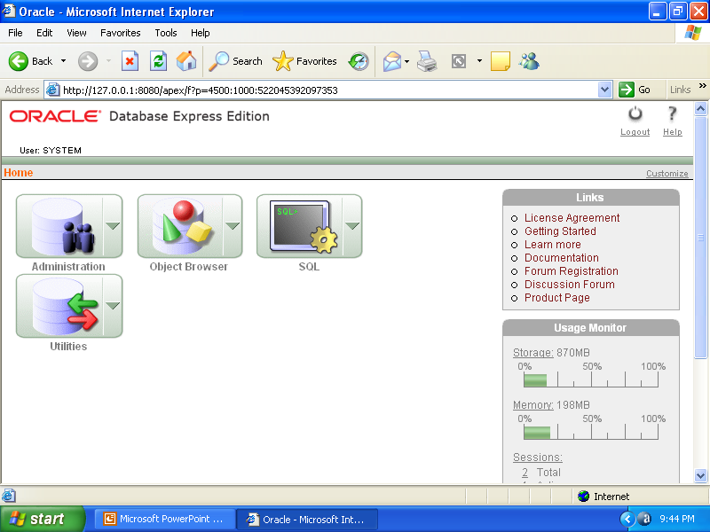
After Log in Oracle 10g…
CLICK HERE

Slide 7
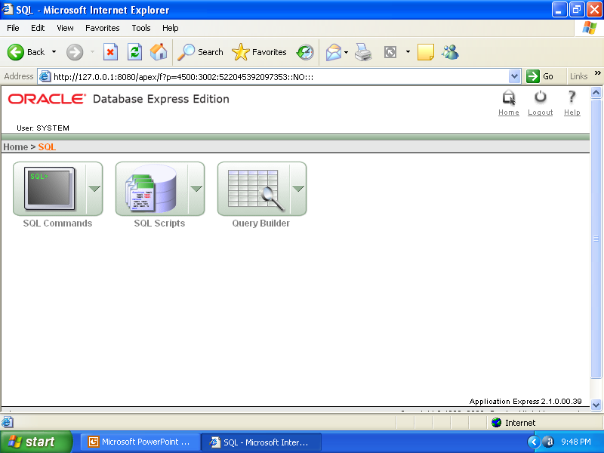
The Next Page…

Slide 8
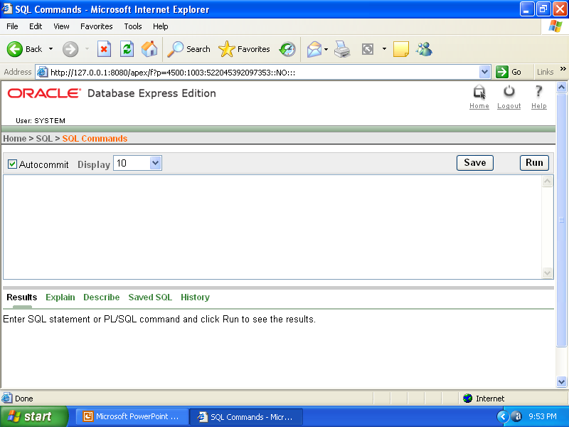
The Desired Working Page…
Here you can write the SQL commands , Then select and Click on Run Button to Execute the SQL commands.

Slide 9
We need the Default tables provided by Oracle Corporation to populate in our working space to test the SQL Commands for preliminary use

Slide 10
The Default table list…
REGIONS TABLE
COUNTRIES TABLE
LOCATIONS TABLE
DEPARTMENTS TABLE
JOBS TABLE
EMPLOYEES TABLE
JOB_HISTORY TABLE
EMP_DETAILS_VIEW VIEW-TABLE

Slide 11
To populate the default schema
Go To : Home>>SQL>>SQL Scripts
CLICK ON Upload Button
And Upload the Two Script Files
hr_cre.sql and hr_popul.sql
Which are present in following path:
Drive:\oraclexe\app\oracle\product\10.2.0\server\demo\schema\human_resources\
Next…

Slide 12
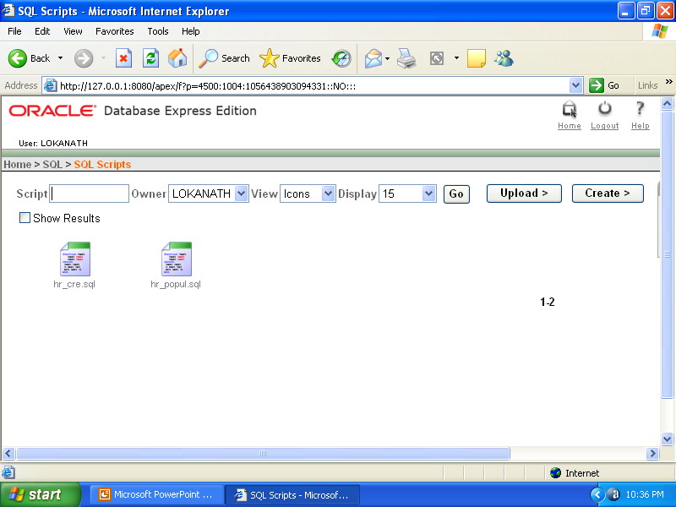
After Uploading the Script Files…
The Script Files

Slide 13
RUNNING THE FILES TO POPULATE DEFAULT TABLES
Click on the Files (hr_cre.sql and hr_popul.sql )
Then Click on Run Button.
One after Another.
Now your Default tables are added to your user space and become convenient to work.

Slide 14
How to Logout...
Click on the Logout Button to Return from Your User Space.
You can Login again By clicking on the Login button also…

Slide 15
Thank You

